Slide 1
Computer Vision

Slide 2

Vision is really hard
Vision is an amazing feat of natural intelligence
Visual cortex occupies about 50% of Macaque brain
More human brain devoted to vision than anything else
Is that a queen or a bishop?

Slide 3
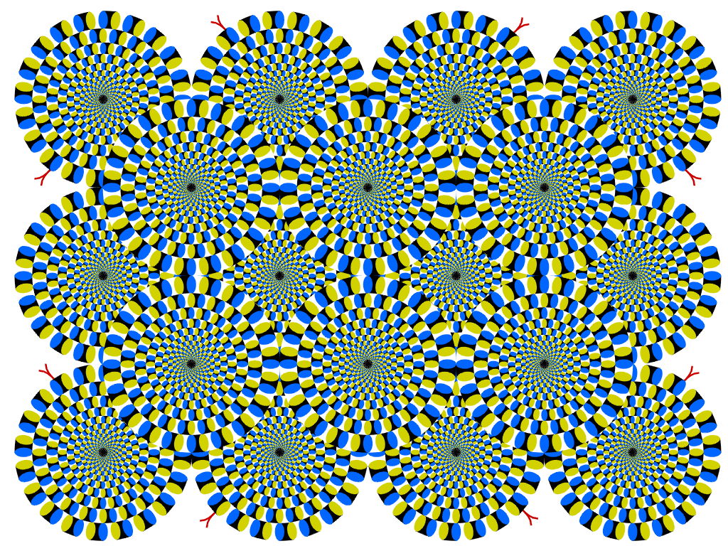
Copyright A.Kitaoka 2003

Slide 4
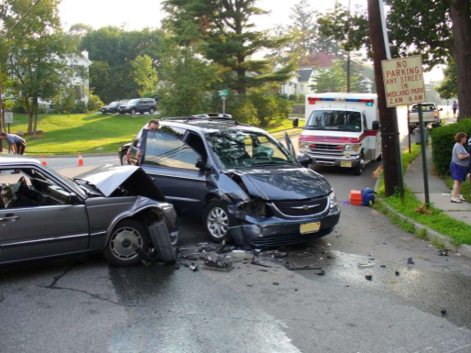
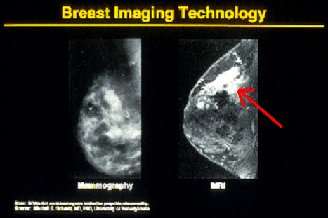


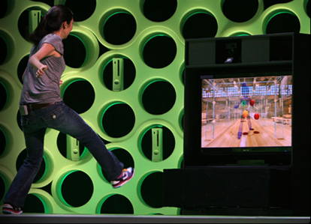

Why computer vision matters
Safety
Health
Security
Comfort
Fun
Access

Slide 5
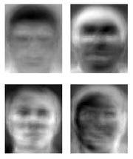
Ridiculously brief history of computer vision
1966: Minsky assigns computer vision as an undergrad summer project
1960’s: interpretation of synthetic worlds
1970’s: some progress on interpreting selected images
1980’s: ANNs come and go; shift toward geometry and increased mathematical rigor
1990’s: face recognition; statistical analysis in vogue
2000’s: broader recognition; large annotated datasets available; video processing starts
Guzman ‘68
Ohta Kanade ‘78
Turk and Pentland ‘91
Notes:
5

Slide 6
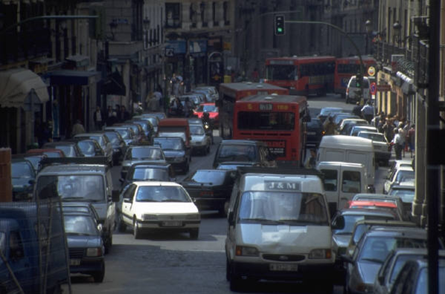
What is Computer Vision?
Given an image or more, extract properties of the 3D world
Traffic scene
Number of vehicles
Type of vehicles
Location of closest obstacle
Assessment of congestion
Location of the scene captured
…

Slide 7
Computer Vision vs. Graphics
3D→2D implies information loss
sensitivity to errors
need for models
graphics
vision

Slide 8
Computer Vision vs. Machine Learning
Machine learning is a scientific discipline that is concerned with the design and development of algorithms that allow computers to change behavior based on data, such as from sensor data or databases (from Wikipedia)
A major focus of machine learning research is to automatically learn to recognize complex patterns and make intelligent decisions based on data.

Slide 9
Computer Vision vs. Machine Learning
Machine Learning is very useful for Computer Vision (e.g., learning for vision)
Computer Vision is more than just learning
Modeling
Example based learning
In Machine Learning, it usually does not care about how to obtain the data or sensors
In Computer Vision, we care how to obtain the visual data (sensor design, active vision), how to represent the visual data, and others

Slide 10
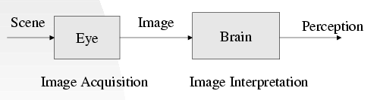
Vision
Vision is the process of discovering what is present in the world and where it is by looking.

Slide 11
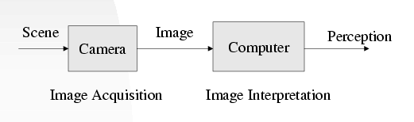
Computer Vision
Computer Vision is the study of analysis of pictures and videos in order to achieve results similar to those as by people.

Slide 12
Why Computer Vision
An image is worth 1000 words
Many biological systems rely on vision
The world is 3D and dynamic
Cameras and computers are cheap
…

Slide 13
Computer Vision Examples
Finding People in images
Problem 1: Given an image I
Question: Does image I contain an image of a person?

Slide 14

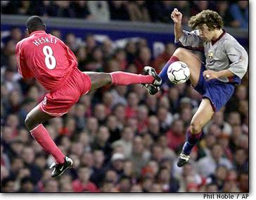
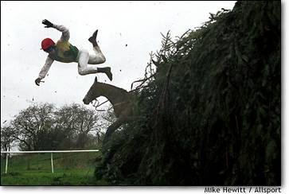
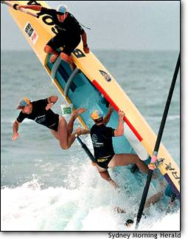
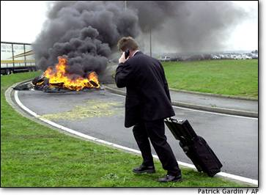
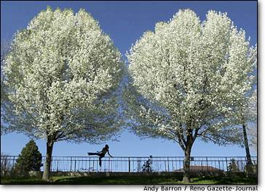
“Yes” Instances

Slide 15
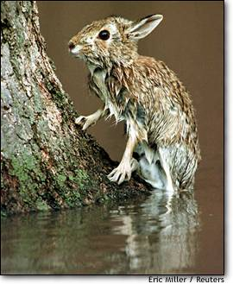
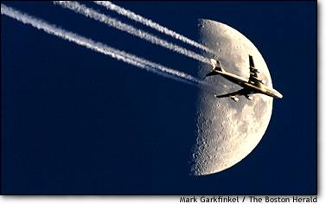
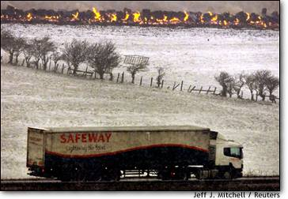
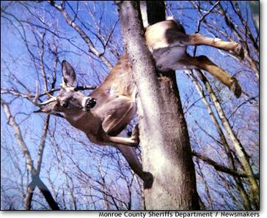
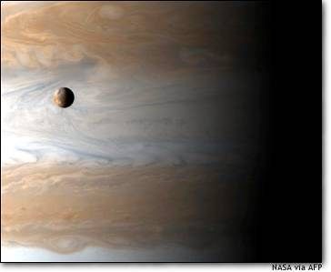
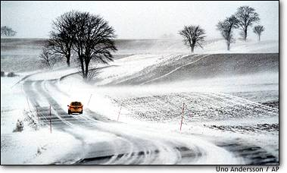
“No” Instances

Slide 16
Some Computer Vision Topics

Slide 17
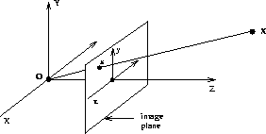
Imaging Geometry

Slide 18
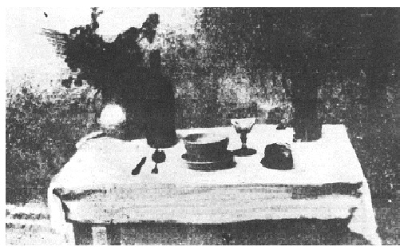
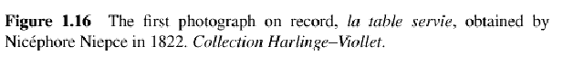
Camera Modeling
Pinhole Cameras
Lenses
Camera Parameters and Calibration

Slide 19

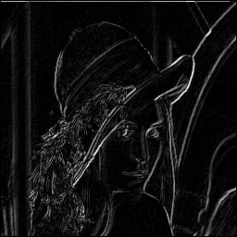
Image Filtering and Enhancing
Linear Filters and Convolution
Image Smoothing
Edge Detection
Pyramids

Slide 20
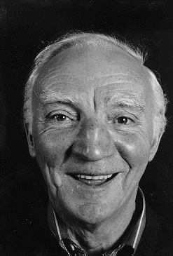
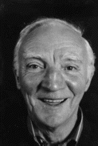

Image Filtering and Enhancing (cont.)

Slide 21

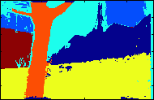
Region Segmentation

Slide 22
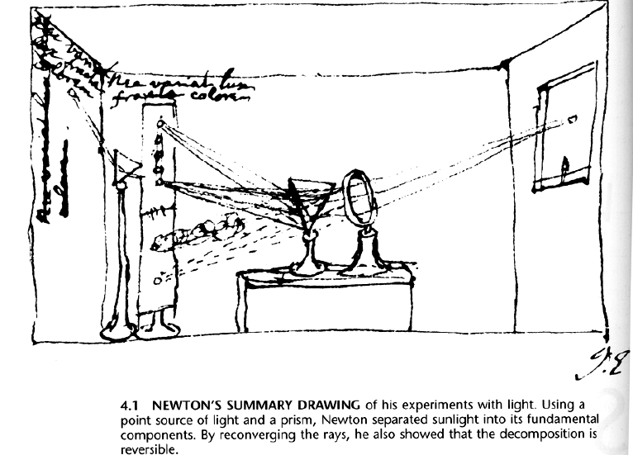
Color

Slide 23
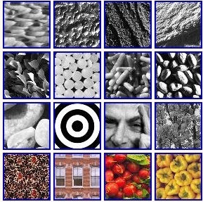
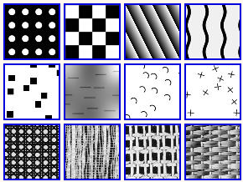
Texture

Slide 24




Image Restoration
Original
Synthetic

Slide 25
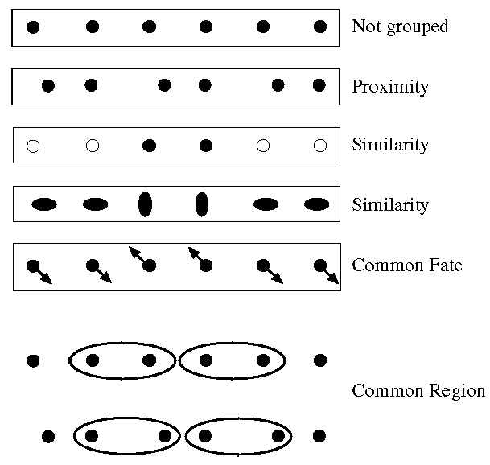
Perceptual Organization

Slide 26
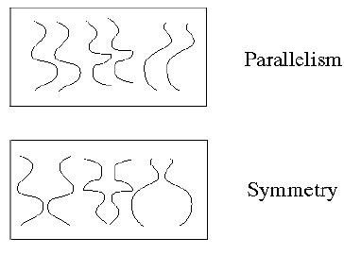
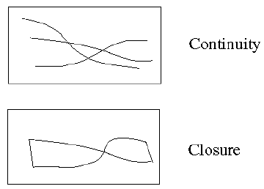
Perceptual Organization

Slide 27
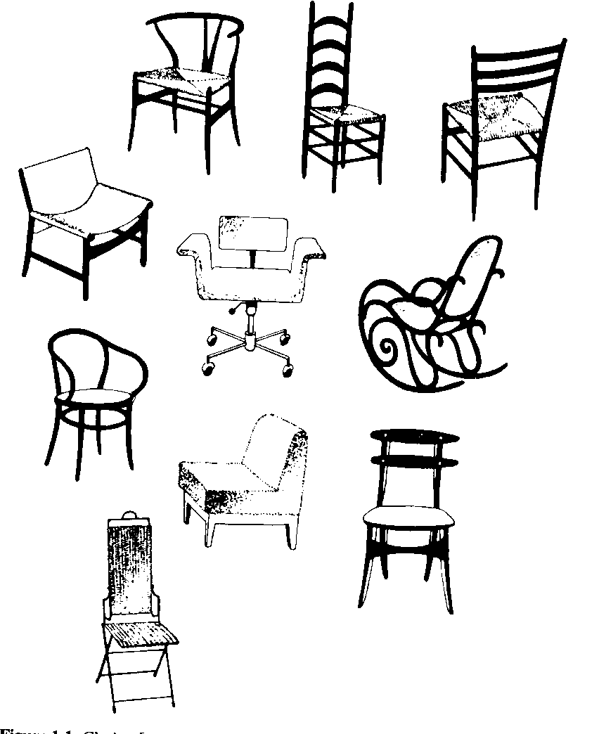

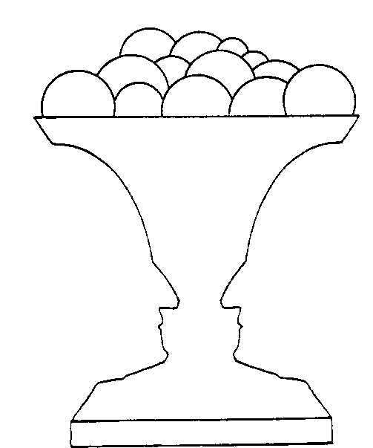
Shape Analysis

Slide 28
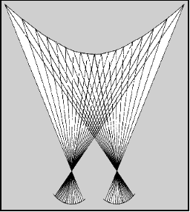
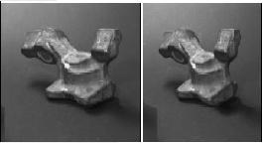
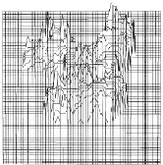
Stereo

Slide 29
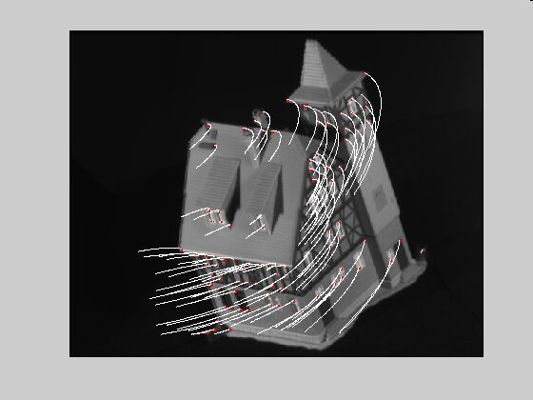
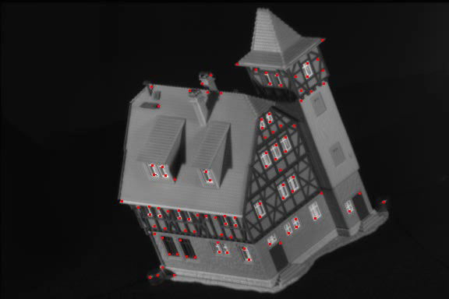
Motion and Optical Flow

Slide 30
High Level Vision

Slide 31

Image Mosaic

Slide 32
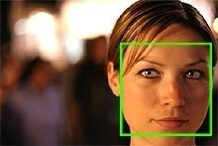
One Very Successful Example
Face detection in a digital camera
The camera detects faces in a scene and then automatically focuses (AF) and optimizes exposure (AE) and, if needed, flash output.

Slide 33
Outline
Introductions
Administrative Matters
Course Outline
Applications of Computer Vision
Computer Vision Focus
Computer Vision Publications

Slide 34
Applications
autonomous cars, planes, missiles, robots, ...
space exploration
aid to the blind, ASL recognition
manufacturing, quality control
surveillance, security, biometrics
image retrieval
medical imaging and analysis
...

Slide 35
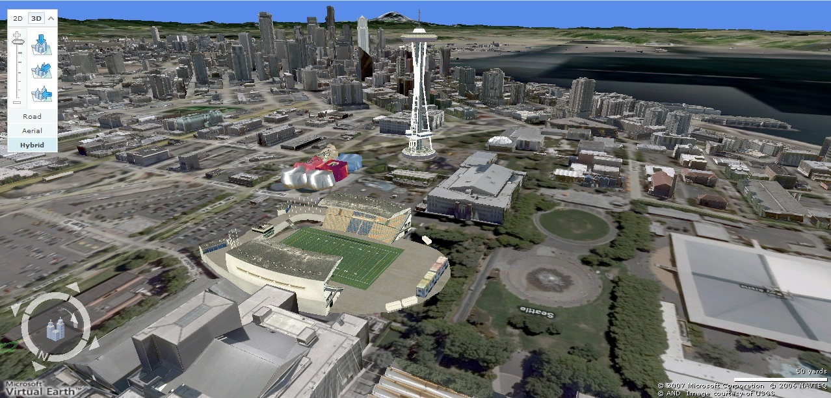
Current State of the Art
Earth viewers (3D modeling)
Image from Microsoft’s Virtual Earth
(see also: Google Earth)

Slide 36
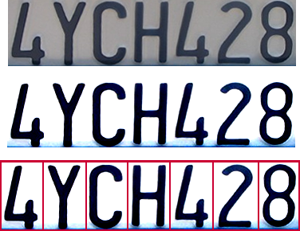

Optical character recognition (OCR)
Technology to convert scanned docs to text
If you have a scanner, it probably came with OCR software
Digit recognition, AT&T labs
http://www.research.att.com/~yann/
License plate readers
http://en.wikipedia.org/wiki/Automatic_number_plate_recognition

Slide 37
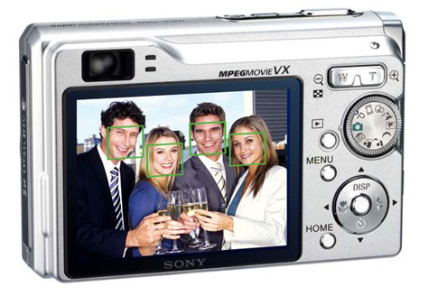
Face detection
Many new digital cameras now detect faces
Canon, Sony, Fuji, …
Notes:
Why would this be useful? Main reason is focus. Also enables “smart” cropping.

Slide 38
Smile detection?
Sony Cyber-shot® T70 Digital Still Camera

Slide 39
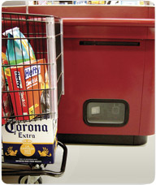
Object recognition (in supermarkets)
LaneHawk by EvolutionRobotics
“A smart camera is flush-mounted in the checkout lane, continuously watching for items. When an item is detected and recognized, the cashier verifies the quantity of items that were found under the basket, and continues to close the transaction. The item can remain under the basket, and with LaneHawk,you are assured to get paid for it… “

Slide 40

Face recognition
Who is she?

Slide 41

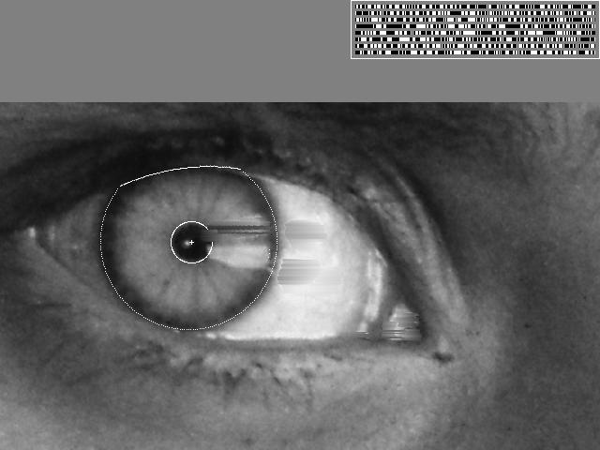
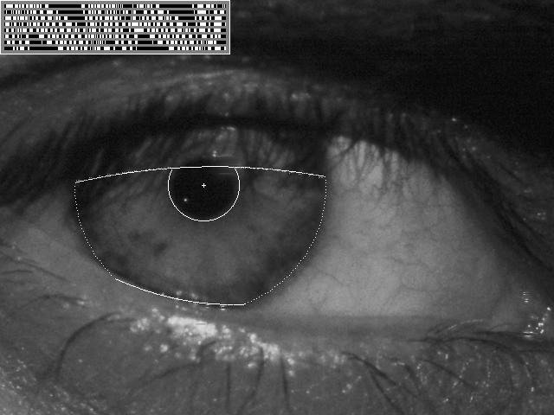
Vision-based biometrics
“How the Afghan Girl was Identified by Her Iris Patterns” Read the story

Slide 42


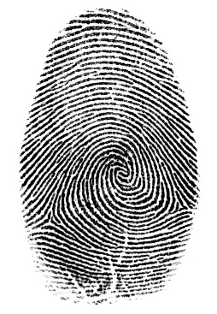

Login without a password…
Fingerprint scanners on many new laptops, other devices
Face recognition systems now beginning to appear more widely http://www.sensiblevision.com/

Slide 43
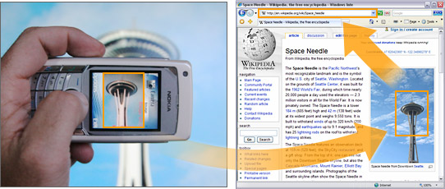

Object recognition (in mobile phones)
This is becoming real:
Microsoft Research
Point & Find, Nokia

Slide 44
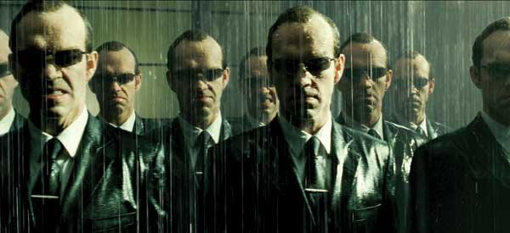
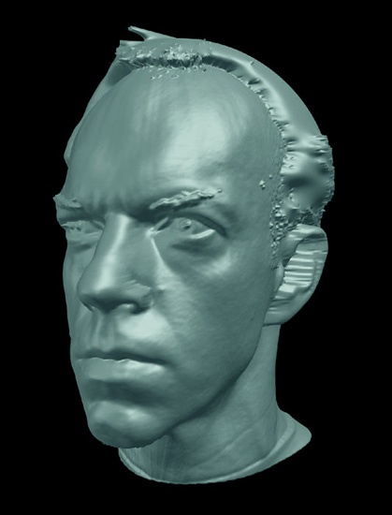
Special effects: shape capture
The Matrix movies, ESC Entertainment, XYZRGB, NRC

Slide 45


Special effects: motion capture
Pirates of the Carribean, Industrial Light and Magic
Click here for interactive demo

Slide 46

Smart cars
Slide content courtesy of Amnon Shashua
Mobileye
Vision systems currently in high-end BMW, GM, Volvo models
By 2010: 70% of car manufacturers.

Slide 47



Vision-based interaction (and games)
Digimask: put your face on a 3D avatar.
Nintendo Wii has camera-based IR tracking built in. See Lee’s work at CMU on clever tricks on using it to create a multi-touch display!
“Game turns moviegoers into Human Joysticks”, CNET
Camera tracking a crowd, based on this work.

Slide 48

Vision in space
NASA'S Mars Exploration Rover Spirit captured this westward view from atop a low plateau where Spirit spent the closing months of 2007.
Vision systems (JPL) used for several tasks
Panorama stitching
3D terrain modeling
Obstacle detection, position tracking
For more, read “Computer Vision on Mars” by Matthies et al.

Slide 49


Robotics
NASA’s Mars Spirit Rover
http://en.wikipedia.org/wiki/Spirit_rover
http://www.robocup.org/

Slide 50


Medical imaging
3D imaging
MRI, CT
Image guided surgery
Grimson et al., MIT

Slide 51
Current state of the art
You just saw examples of current systems.
This is a very active research area, and rapidly changing
Many new apps in the next 5 years
To learn more about vision applications and companies
David Lowe maintains an excellent overview of vision companies
http://www.cs.ubc.ca/spider/lowe/vision.html

Slide 52
Outline
Introductions
Administrative Matters
Course Outline
Applications of Computer Vision
Computer Vision Focus
Computer Vision Publications

Slide 53

Computer Vision focuses on:
What information should be extracted?
How can it be extracted?
How should it be represented?
How can it be used to achieve the goal?

Slide 54
Related disciplines
Image processing
Pattern recognition
Photogrammetry
Computer graphics
Artificial intelligence
Machine learning
Projective geometry
Control theory

Slide 55
Active Research Topics
Object recognition
Human behavior analysis
Internet and computer vision
Biometrics and soft biometrics
Large scale 3D reconstruction (city level)
Medical image processing
Vision for robotics
…

Slide 56
Outline
Introductions
Administrative Matters
Course Outline
Applications of Computer Vision
Computer Vision Focus
Computer Vision Publications

Slide 57
Computer Vision Publications
Journals
IEEE Trans. on Pattern Analysis and Machine Intelligence (TPAMI)
#1 IEEE, Thompson-ISI impact factor: 5.96
#1 in both electrical engineering and artificial intelligence
#3 in all of computer science
Internal Journal of Computer Vision (IJCV)
ISI impact factor: 5.358, Rank 2 of 94 in “CS, artificial intelligence
IEEE Trans. on Image Processing
…

Slide 58
Importance of CV
From these major journal rankings, we can see the importance of Computer Vision research in the whole areas of
Computer Science
Electrical Engineering

Slide 59
Computer Vision Publications
Conferences
International Conference on Computer Vision (ICCV), once every two years
Conf. of Computer Vision and Pattern Recognition (CVPR), once a year
Europe Conference on Computer Vision (ECCV), once every two years
…

